Slide 1
weakly synchronous protocol
Byzantine Fault Tolerant (+2/3)
Tendermint

Slide 2
Algorithm
1. Validator weights are set.
2. The validator is elected as the leader and a new block is proposed.
3. The weights are recalculated and a slight amount decreases after the round is
complete.
4. As each round progresses, the added value increases in proportion to the voting
rights.
5. Among the validators, the leader is again elected.

Slide 3
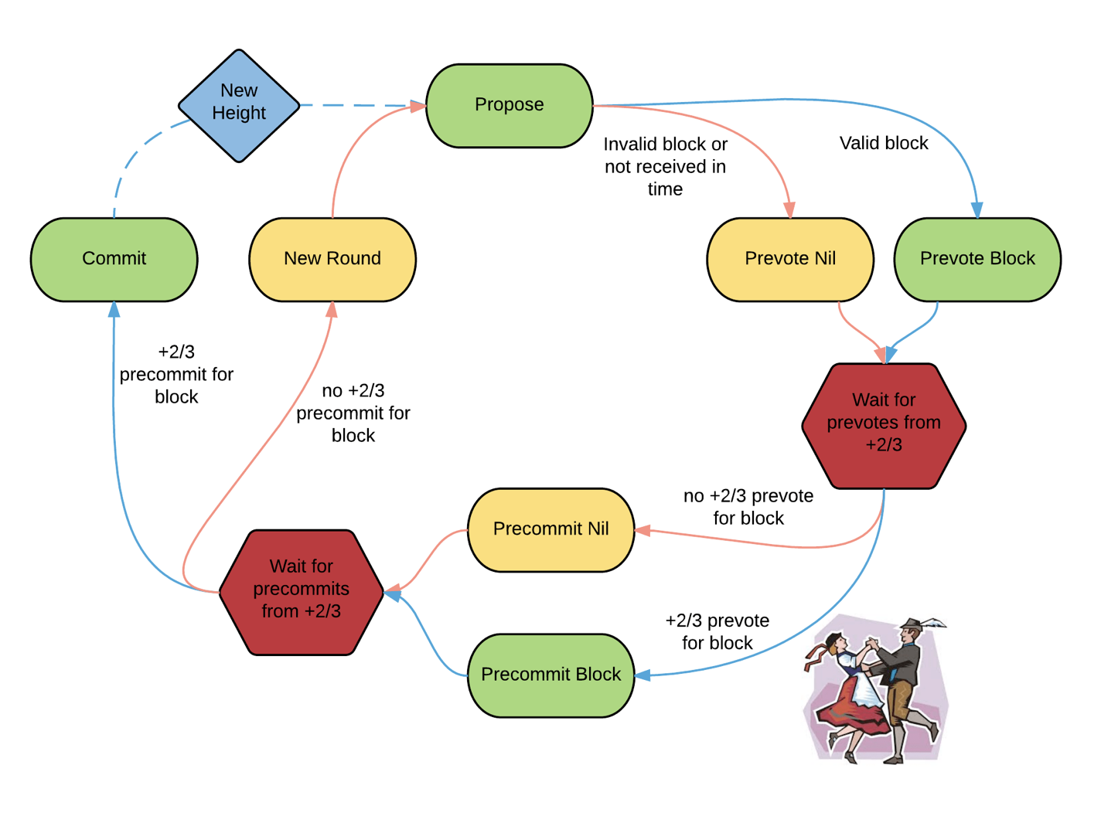
polka

Slide 4
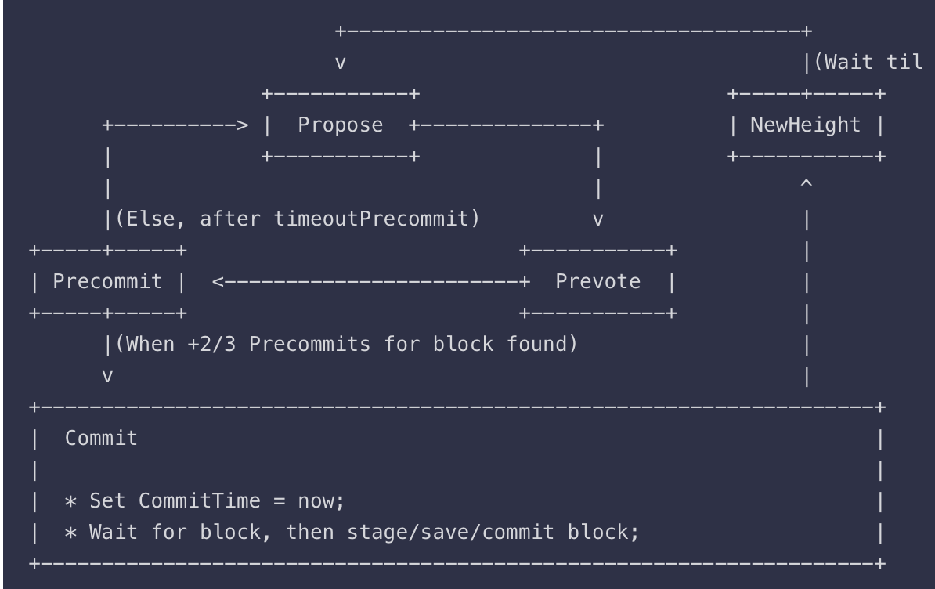
Round =>

Slide 5
Propose
Propose at (H, R). =>
timeoutProposeR after propose
receiving proposal block and all prevotes at PoLC-Round
= Prevote(H, R)

Slide 6
Prevote
Unlock the block if have another PoLC in
LastLockRound < PoLC-Round < R
If the validator is still locked on a block, it prevotes that.
Else, if the proposed block from Propose(H,R) is good
prevotes block
Else, if the proposal is invalid or wasn't received on time, prevotes <nil>.
precommit(H, R)
timeoutPrevote, go to precommit(H, R)

Slide 7
Precommit
Have PoLC for box => relock and precommit, set LastLockRound = R
Have PoLC for Nil => unlock and precommit
Unchange and precommit Nil
Precommit Nil : Propose(H, R+1)
After timeoutPrecommit after receiving any +2/3 precommits. --> gotoPropose(H,R+1)

Slide 8


Make “proof block”
(only if the application hash changed)

Slide 9
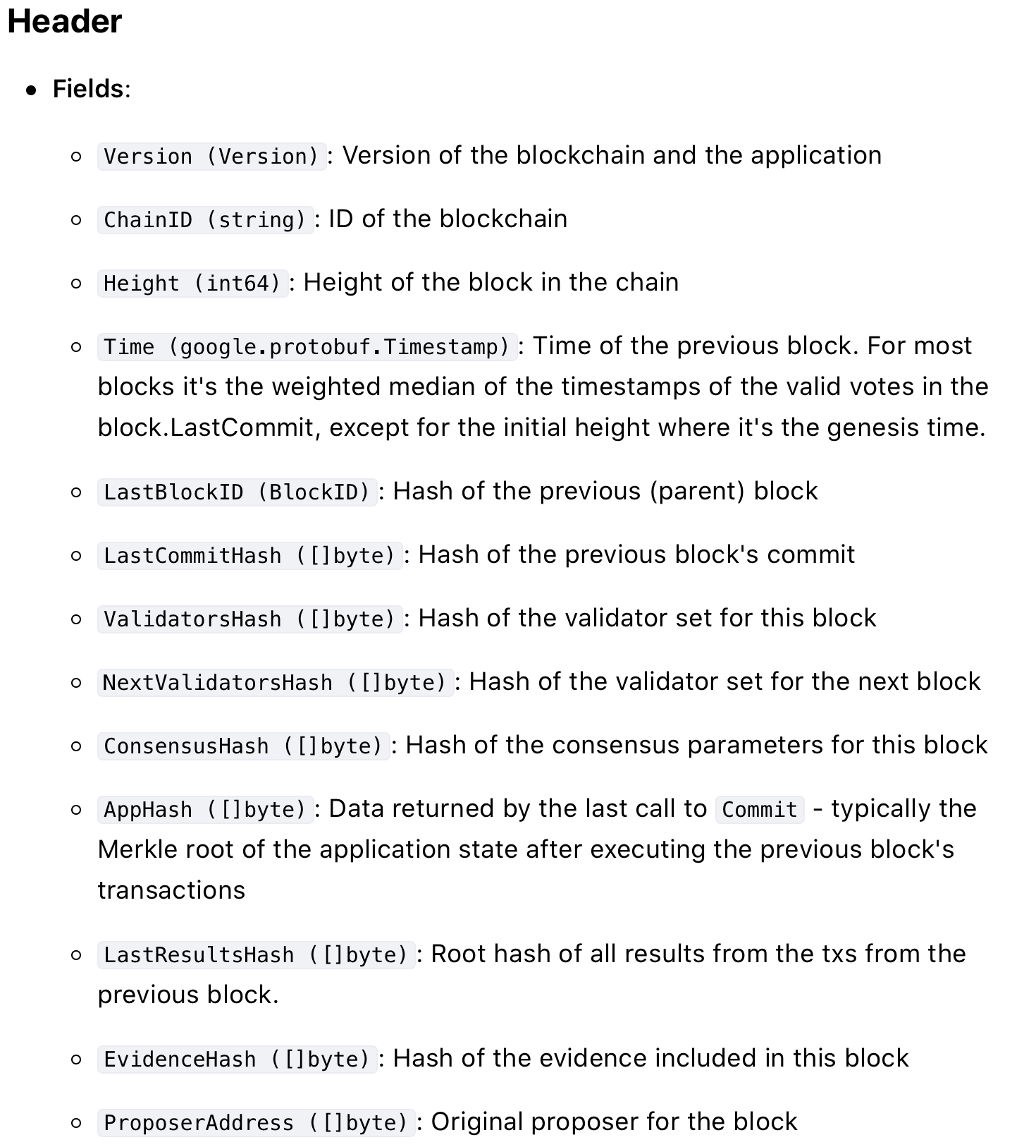
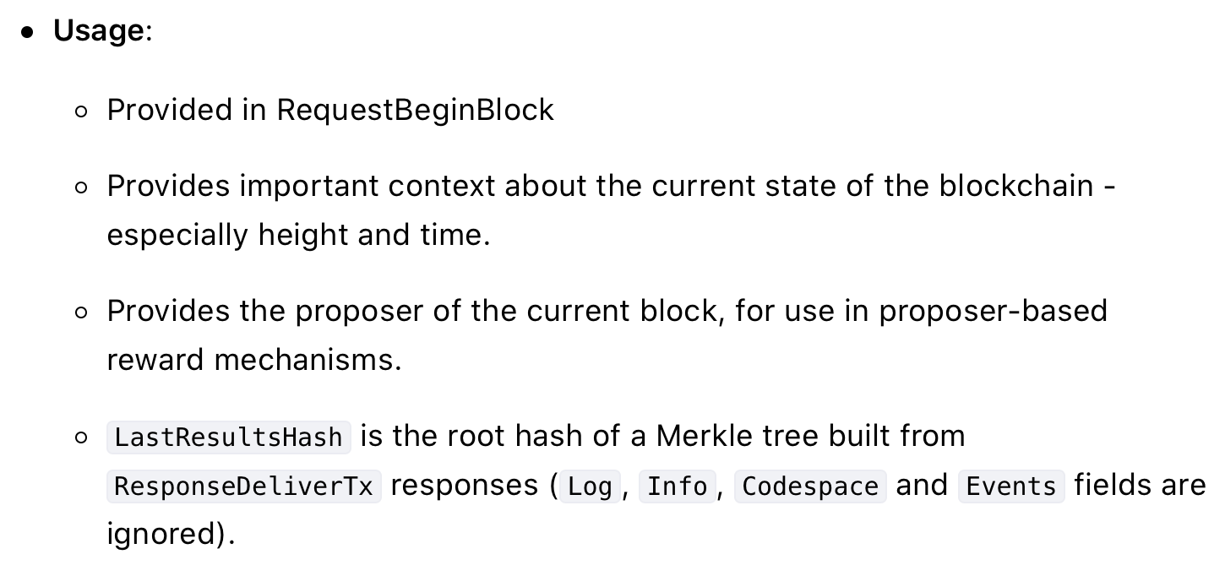

Slide 10
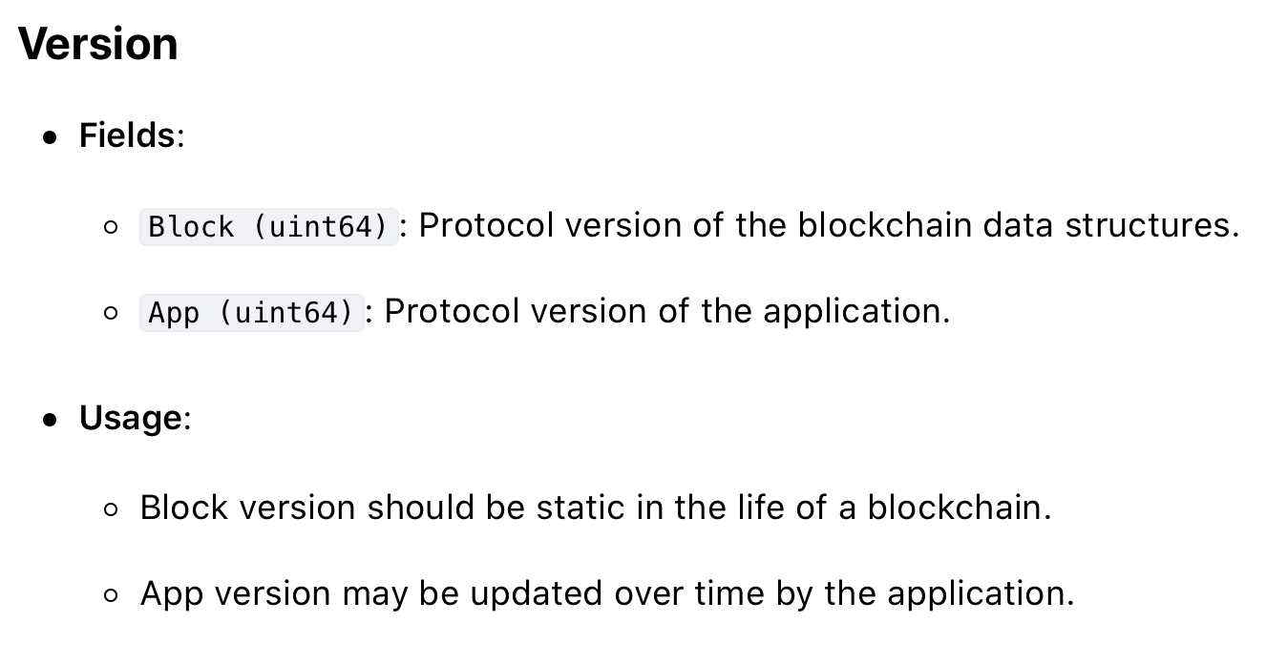

Slide 11
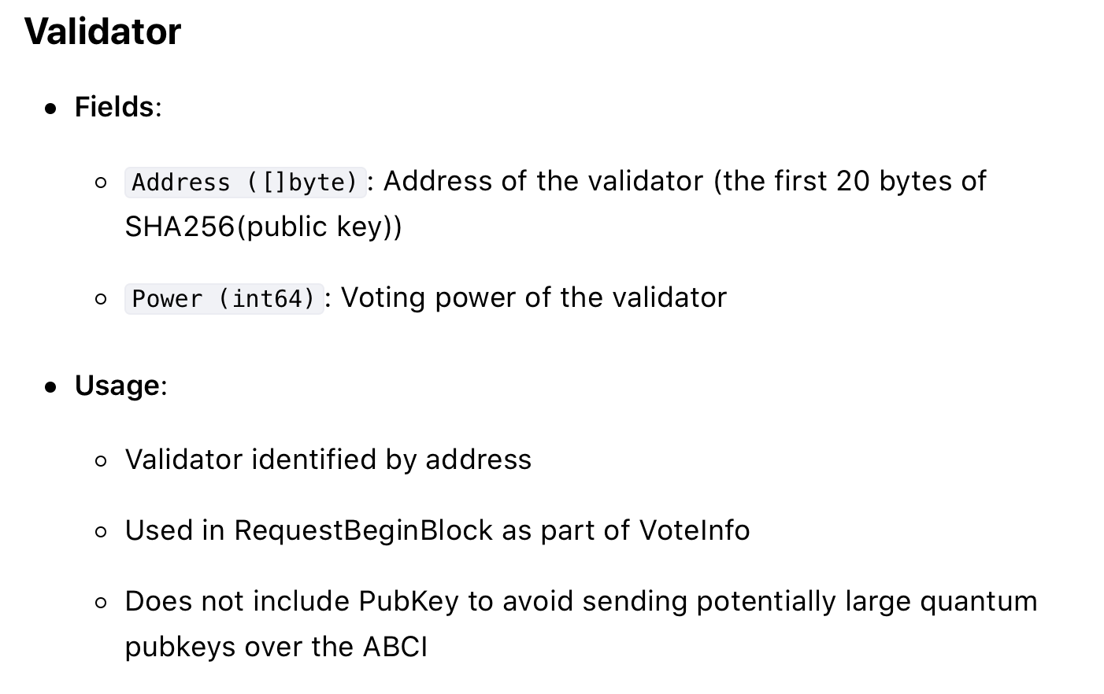

Slide 12
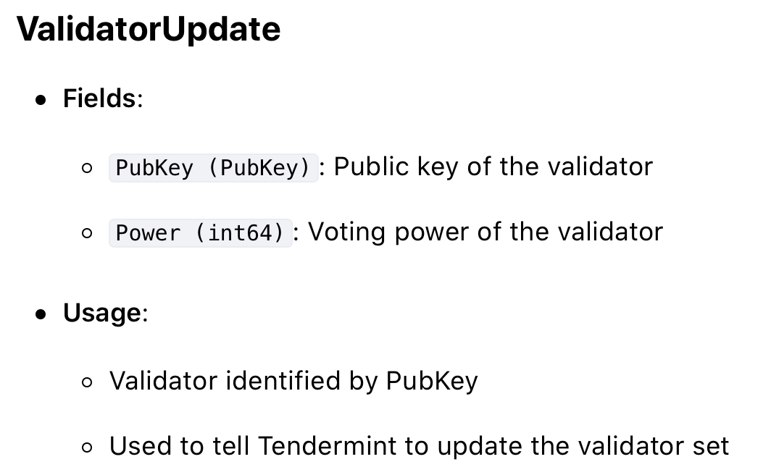

Slide 13
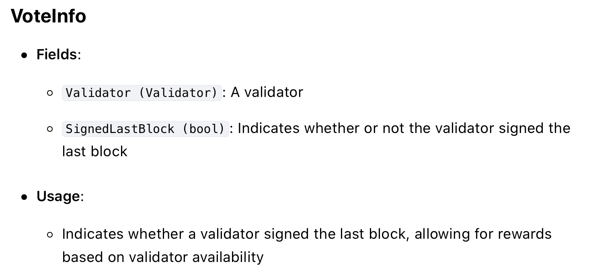

Slide 14
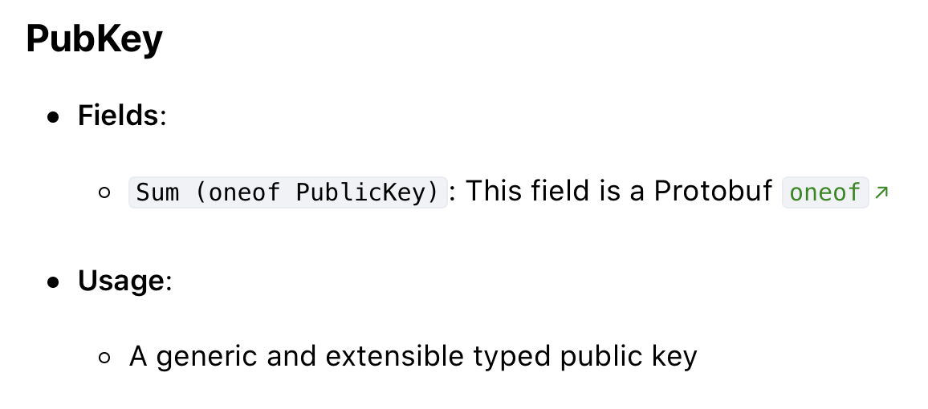
https://godoc.org/github.com/tendermint/tendermint/types#Vote

Slide 15
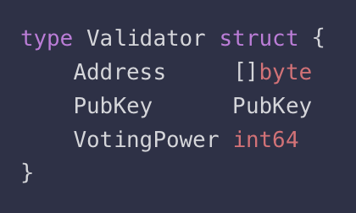
Validator

Slide 16
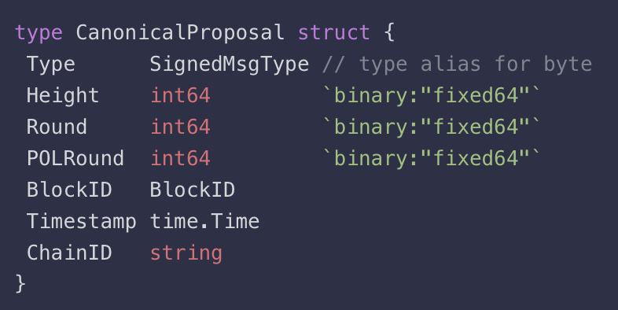
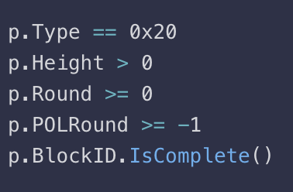
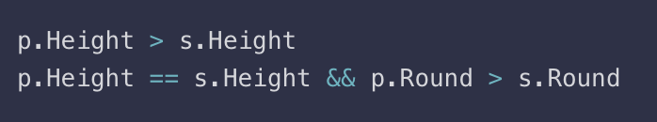

Slide 17
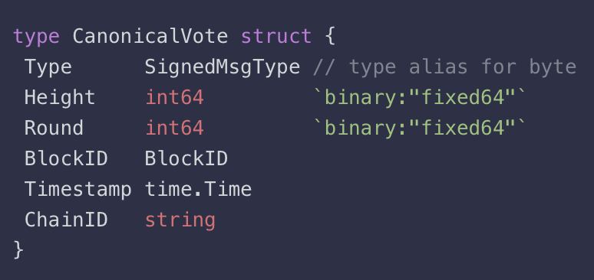
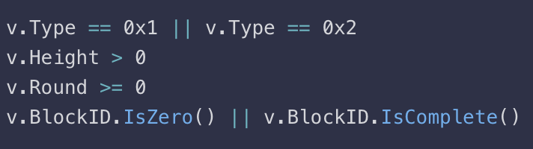
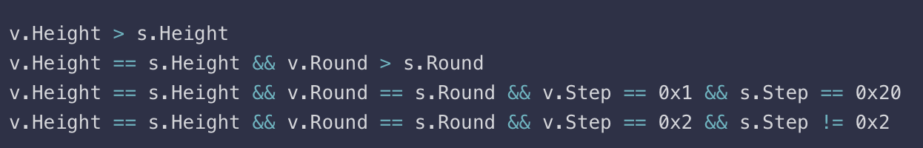
https://github.com/tendermint/tendermint/blob/master/types/validator_set.go#L50

Slide 18
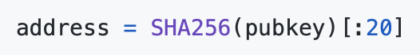
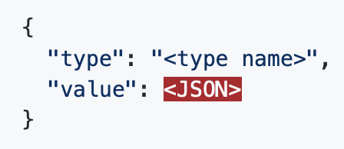
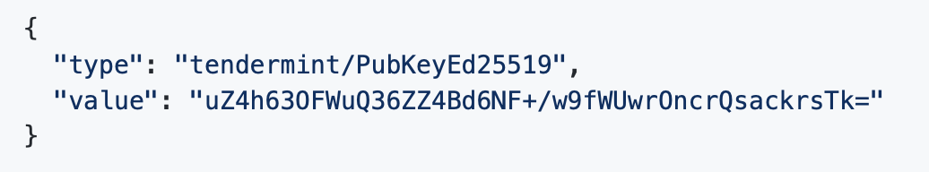
Datatype : Encoding
Protocol buffers : proto3(protobuf)
Byte array : [0xA, 0xB] -> 0x020A0B
Hashing : SHA(ProtoEncoding(obj))
JSON encoding
ED25519 Pubkey

Slide 19
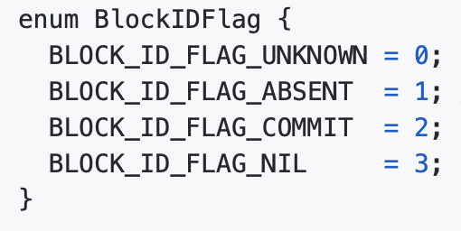
Datatype : Block
Header : Version, ChainID, Height …
Data : list of transactions
Evidence : Array of evidence
LastCommit : Commit(set of validator)
Datatype : Commit
Height(Int64), Round(Int32), BlockID, Signatures(Array CommitSig)
-CommitSig : BlockIDFlag ->
ValidatorAddress
TimeStamp
Signature

Slide 20
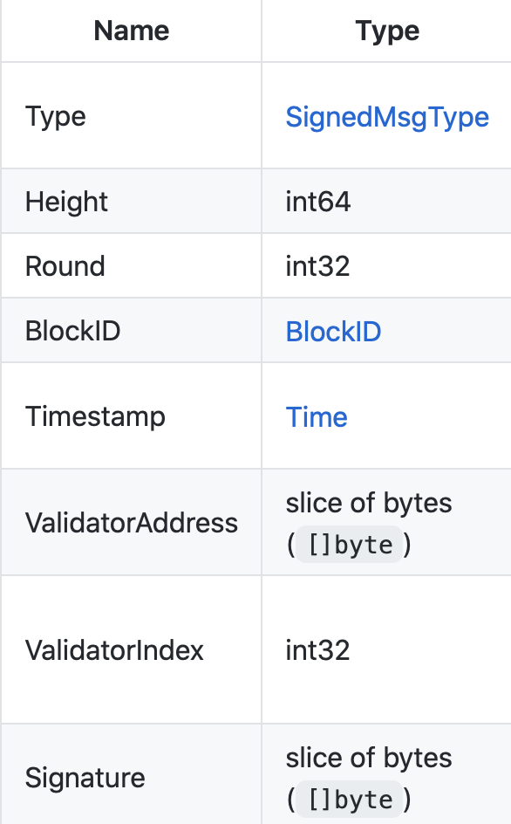
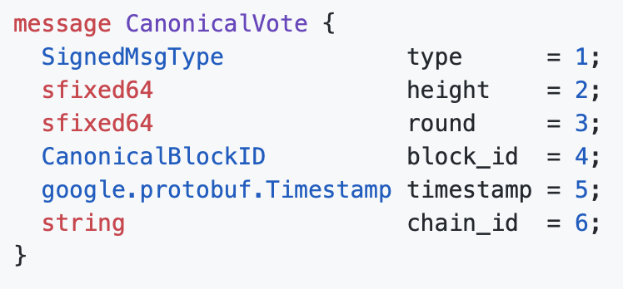
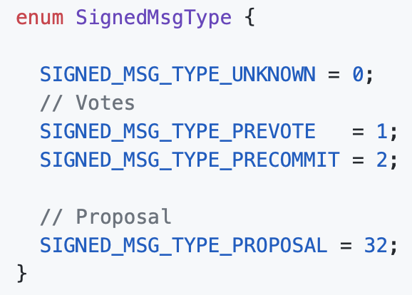
Datatype : Vote

Slide 21
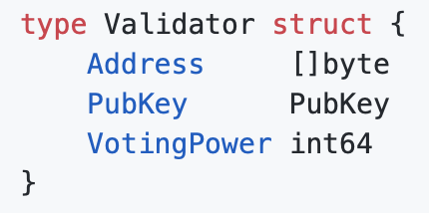
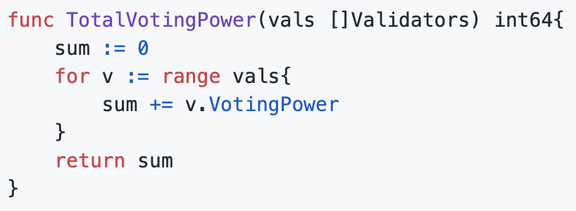
Datatype : ValidatorSet
Validators : Array of Validator
Proposal : The block proposer for the corresponding block
Datatype : Validator

Slide 22
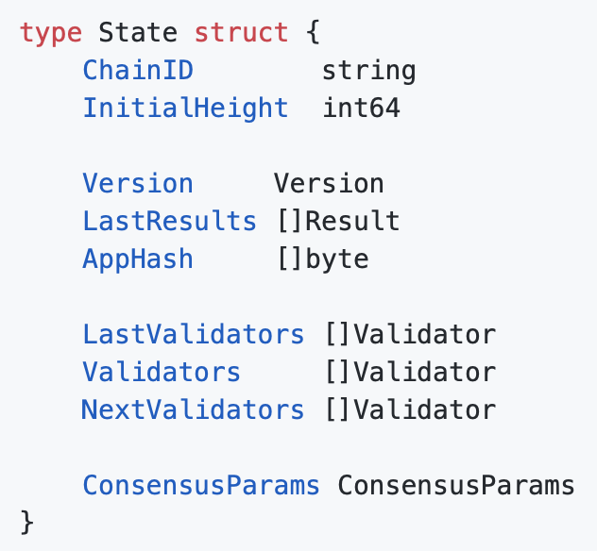
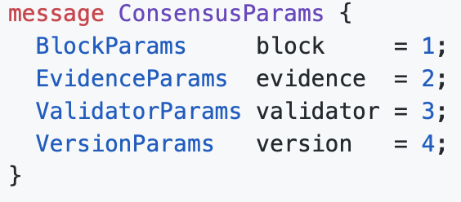
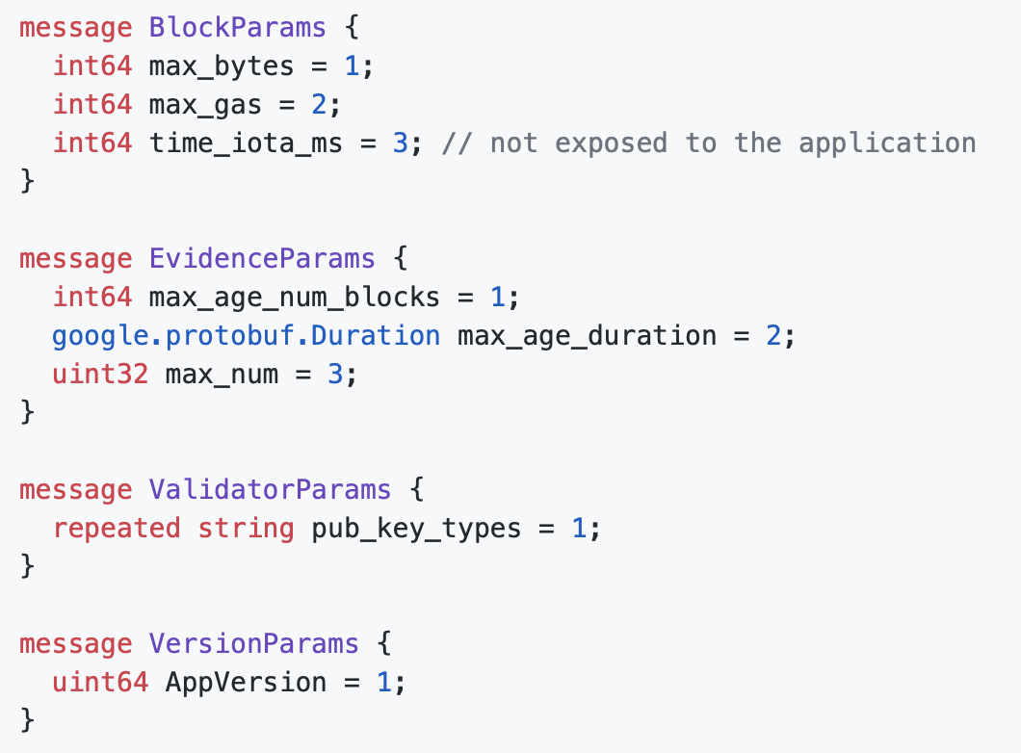
Datatype : State

Slide 23
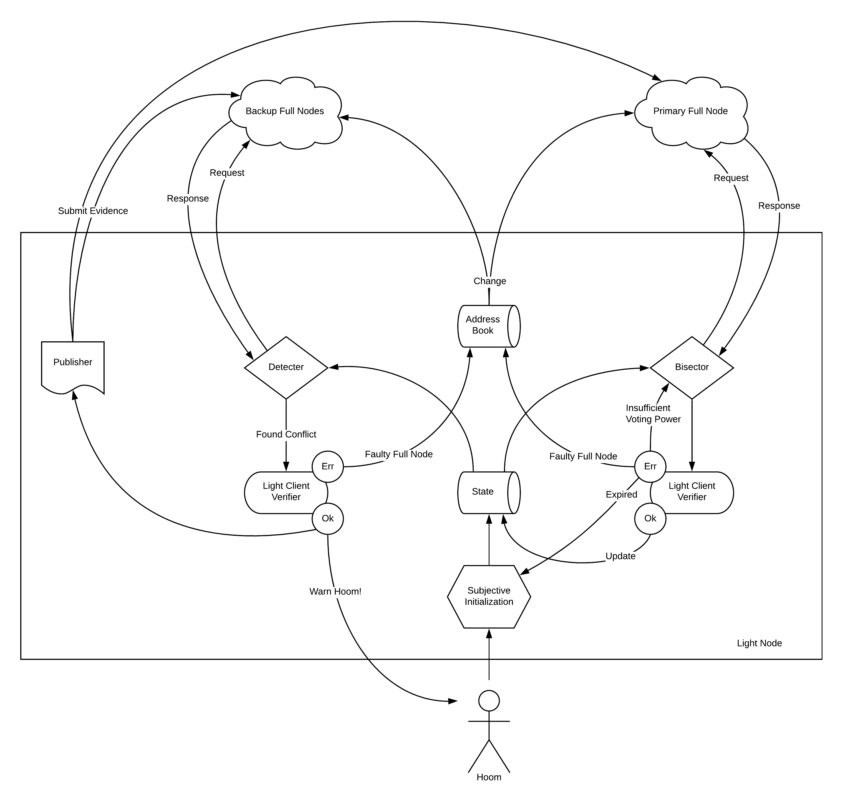
WAL(write-ahead log) : write every message
Light Client Protocol
: light weight, least processing

Slide 24
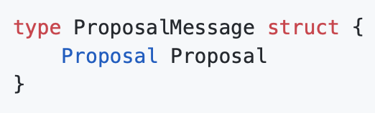
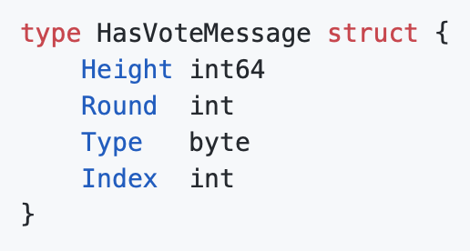
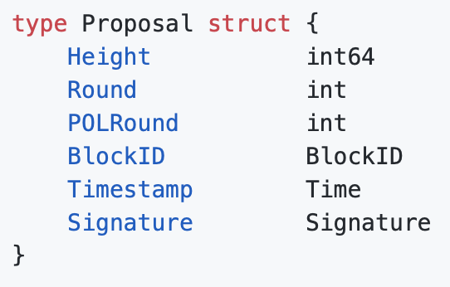
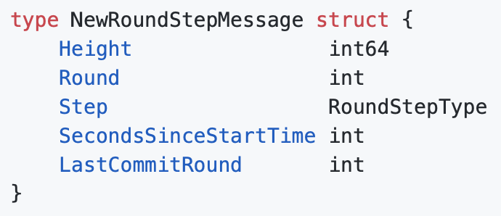
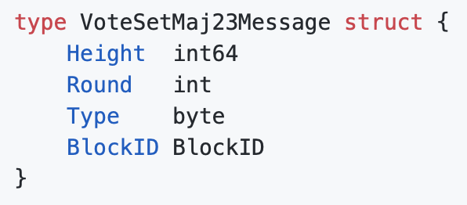
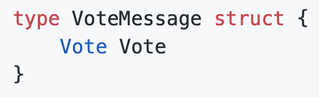
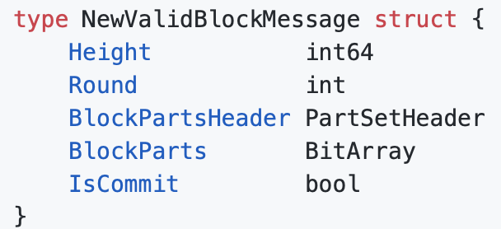
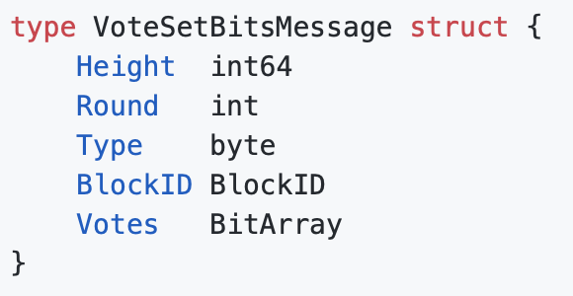
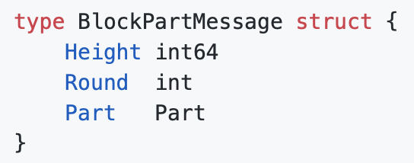
Validator send to peer information
Process to peer
Core consensus Algorithm

Slide 25
WAL
Send message
Node1
Node2
(validator)
Read data & consensus
Node3
(validator)
Send message
State
Notes:
State에 관하여 정리. State의 존재 방향

Slide 26
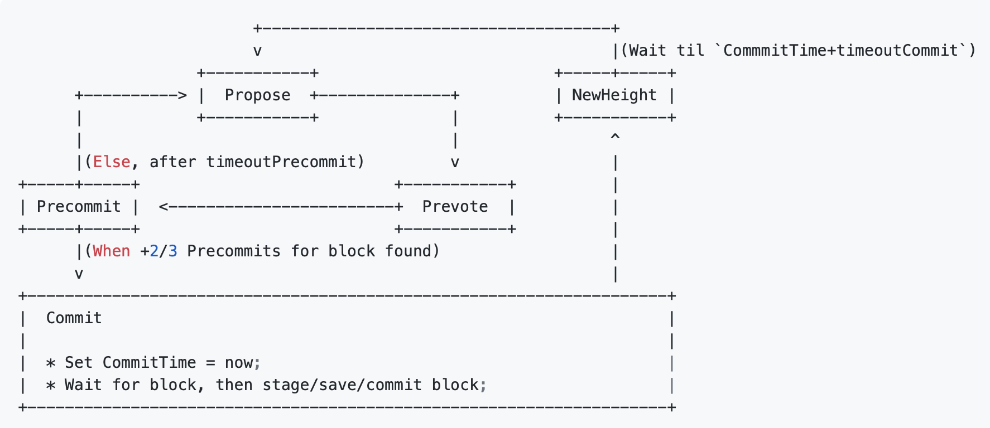

Slide 27
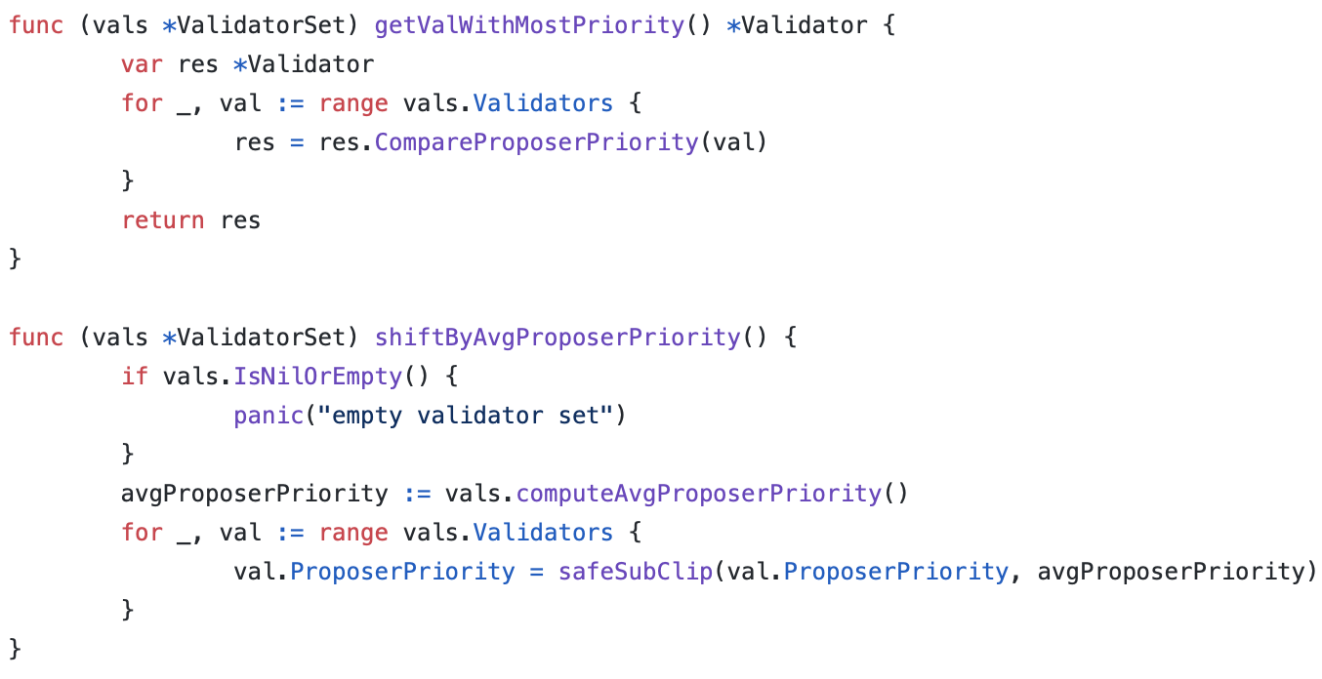
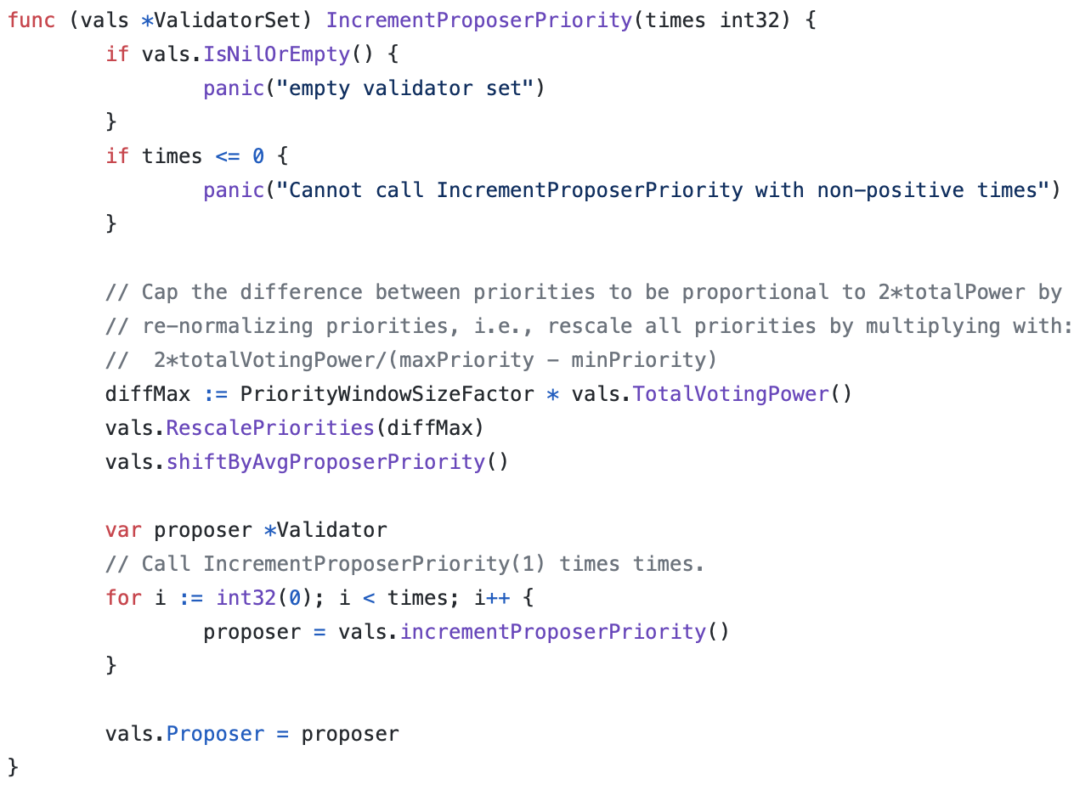
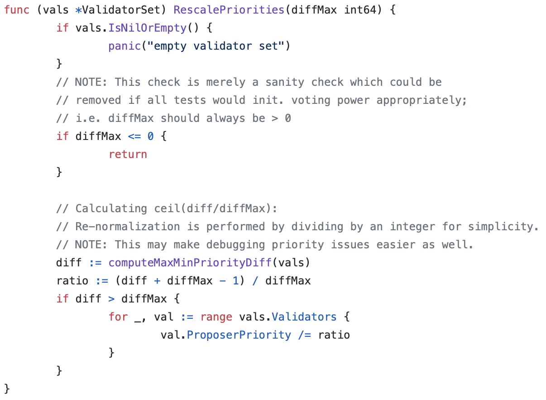
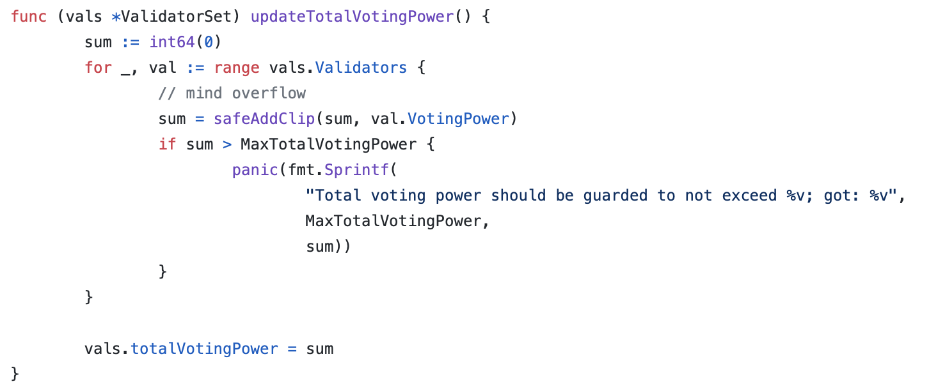
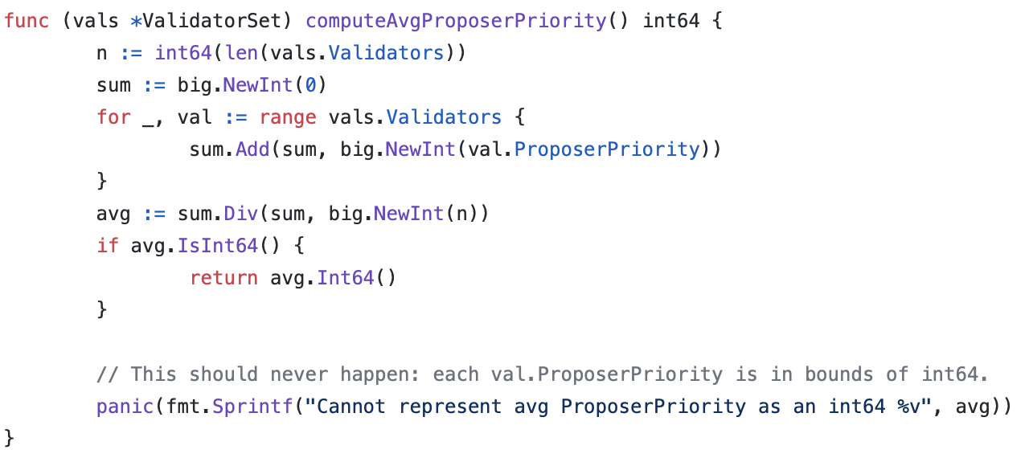
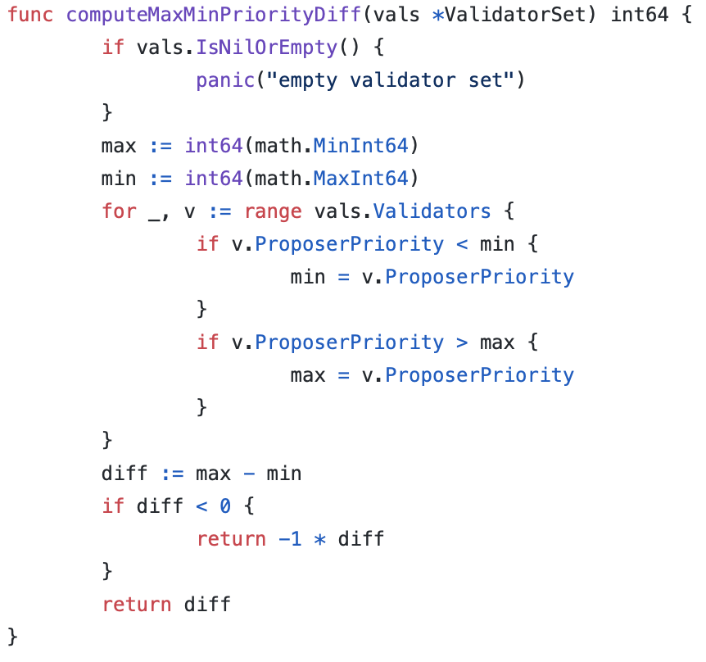
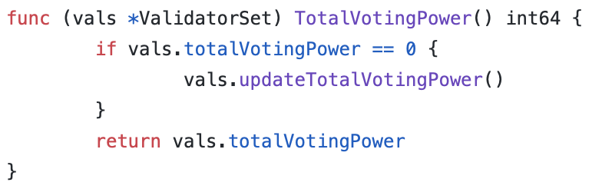

Slide 28
vset = validator set
A(i) = priority of validator i
VP(i) = voting power of validator i
def ProposerSelection (vset):
diff = max(A)-min(A)
threshold = 2 * P
if diff > threshold:
scale = diff/threshold for each validator i in vset:
A(i) = A(i)/scale
avg = sum(A(i) for i in vset)/len(vset)
for each validator i in vset:
A(i) -= avg
for each validator i in vset:
A(i) += VP(i)
proposer = max(A)
A(proposer) -= P
Notes:
Voting power 어떻게 정의되는지
Spec에 존재하지 않는 내용 정리

Slide 29
priority | -2 | -1 | 0 | 1 | 2 | 3 | 4 | 5
 |  |  | p1, p2
round1 |  |  |  | p1 |  | p2
 |  | p2 |  | p1
round2 |  |  |  |  | p1, p2
 | p1 |  |  |  | p2
round3 |  | p1 |  |  |  |  |  | p2
 |  | p1 |  | p2
round4 |  |  | p1 |  |  |  | p2
 |  |  | p1, p2
validator | p1 | p2
VP | 1 | 3

Slide 30
priority | -2 | -1 | 0 | 1 | 2 | 3 | 4 | 5
 |  |  | p1, p2
round1 |  |  |  | p1 |  | p2
 |  | p2 |  | p1
round2 |  |  |  |  | p2 |  |  | p1
 | p1 |  |  |  | p2
round3
round4
validator | p1 | p2
VP | 4 | 3

Slide 31
priority | -3 | -2 | -1 | 0 | 1 | 2 | 3 | 4
 | p3 |  |  |  | p1 | p2
remove
center |  | p3 |  |  |  | p1
validator | p1 | p2 | p3
VP | 1 | 2 | 3

Slide 32
priority | -13 | -9 | -5 | -2 | -1 | 0 | 1 | 2
 |  |  |  | p2 |  |  |  | p1
add
 | p3 |  |  | p2 |  |  |  | p1
center |  | p3 |  |  |  |  |  | p2
A(V) = -1.125 * P
validator | p1 | p2 | p3
VP | 1 | 3 | 8

Slide 33
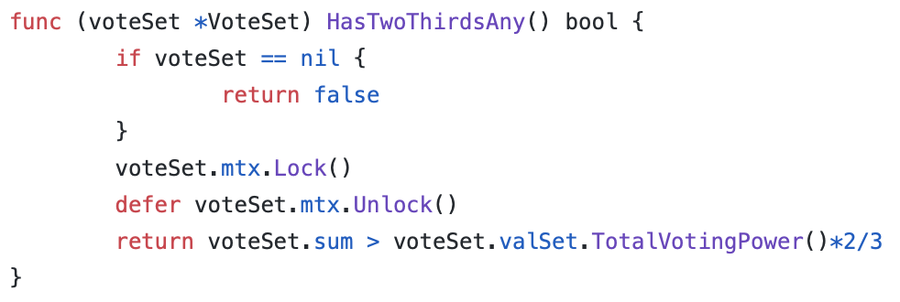
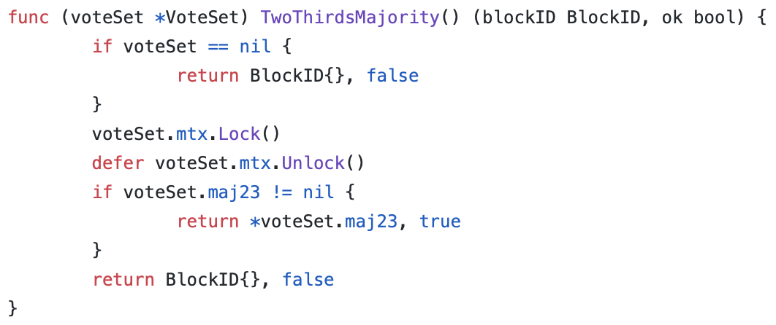

Slide 34
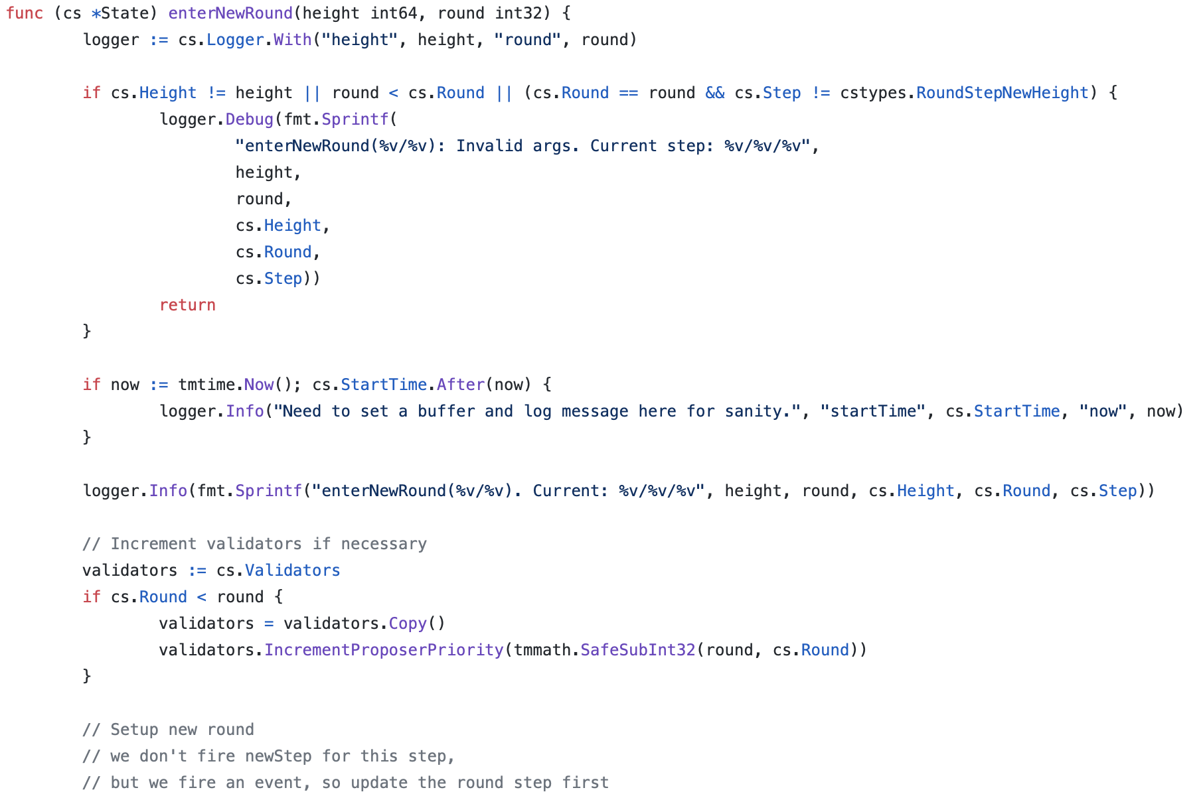
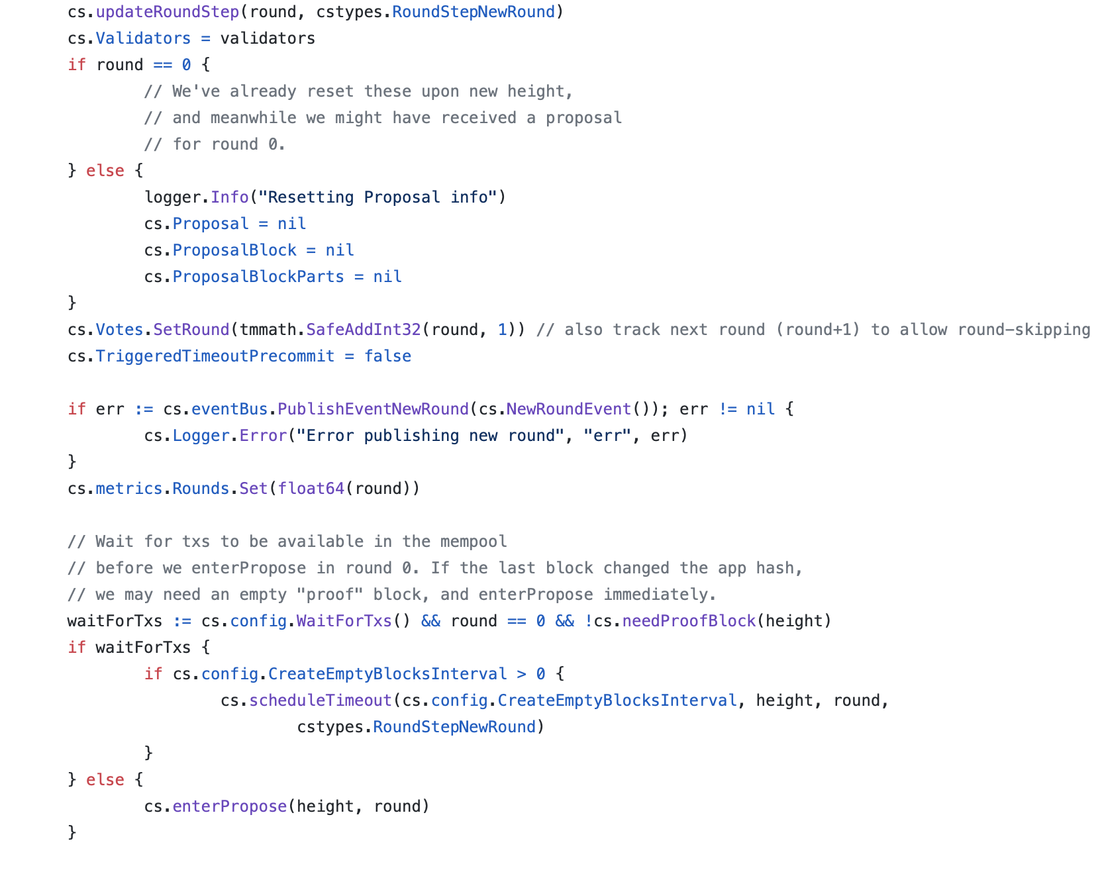

Slide 35



Slide 36


Slide 37


Slide 38


Slide 39


Slide 40


Slide 41


Slide 42


Slide 43


Slide 44


Slide 45


Slide 46


Slide 47


Slide 48


